Slide 1
SQL Project with PostgreSQL
Finding the Suitable Job Over Various Job Platforms
Special Thanks :-
Luke Barousse
- Fardeen Ahmed Khan

Slide 2
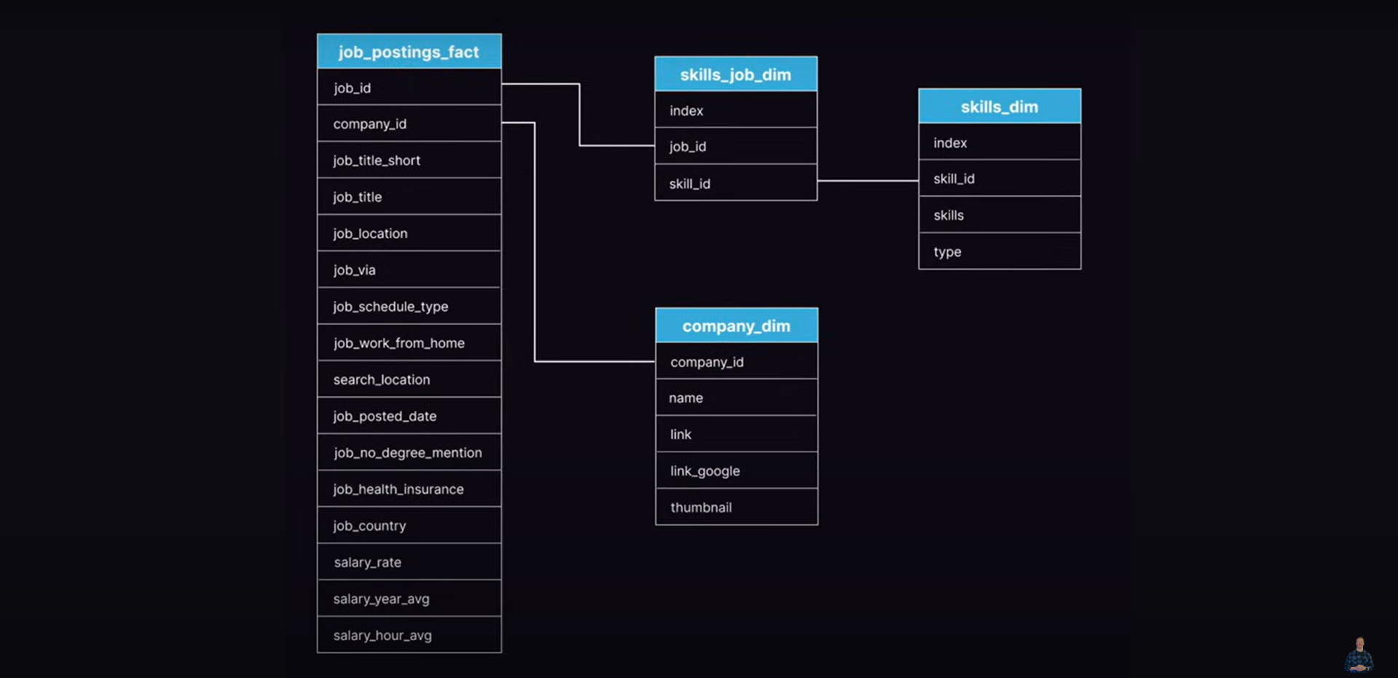
Database Structure – Depicting Relationship Between Tables and Keys Relating Them

Slide 3
Question 1 - What are the Top Paying Data Analyst jobs? - Identify the top 10 Highest paying Data Analyst Jobs available Remotely - Focus on job postings with specifies Salary amount excluding nulls - Why? Highlight the top-paying opportunities for Data Analyst
SELECT
job_id,
job_title,
company_table.name as Company_Name,
job_location,
job_schedule_type,
salary_year_avg,
job_posted_date
from job_postings_fact as jobs_table
LEFT JOIN company_dim as company_table
ON jobs_table.company_id = company_table.company_id
where
job_title_short='Data Analyst' and job_location = 'Anywhere' and salary_year_avg IS NOT NULL
ORDER BY salary_year_avg DESC
LIMIT 10;

Slide 4
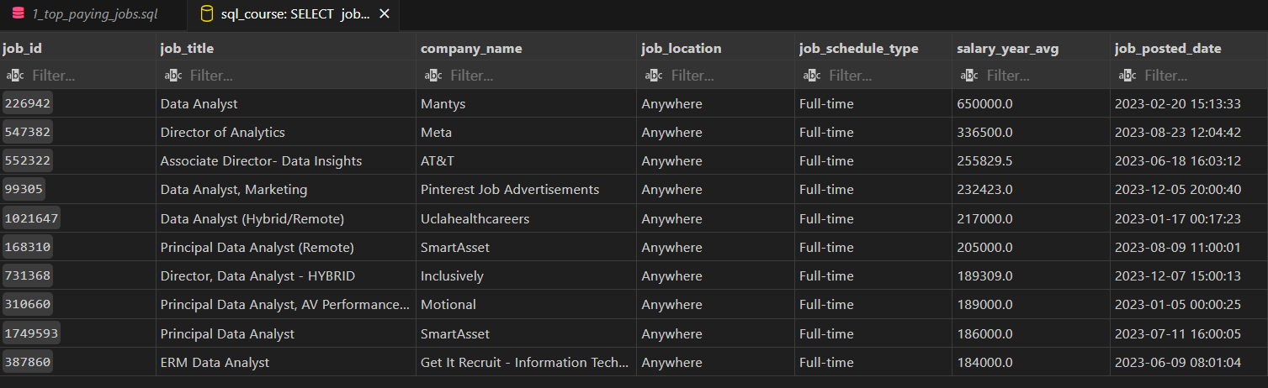
The Top 10 Data Analyst Jobs Available for Work From Home i.e. Anywhere With Highest Salary In Desc Order.

Slide 5
Question 2 - What skills are required for top paying Data Analyst jobs covered in previous Quaetion - Use the first query where we found top 10 data analyst remote jobs - Add specific skills required for that role - Why? It provide a detailed view skills for that high paying jobs helping job seekers in learning with skill can get them high paying jobs
with top_paying_jobs as (SELECT
job_id,
job_title,
salary_year_avg,
company_table.name as Company_Name
from job_postings_fact as jobs_table
LEFT JOIN company_dim as company_table
ON jobs_table.company_id = company_table.company_id
where
job_title_short='Data Analyst' and job_location = 'Anywhere' and salary_year_avg IS NOT NULL
ORDER BY salary_year_avg DESC
LIMIT 10)
SELECT
top_paying_jobs.*,
skills
from top_paying_jobs
INNER JOIN skills_job_dim as skills_to_jobs ON top_paying_jobs.job_id = skills_to_jobs.job_id
INNER JOIN skills_dim as skills_name on skills_to_jobs.skill_id = skills_name.skill_id
ORDER BY salary_year_avg DESC;

Slide 6
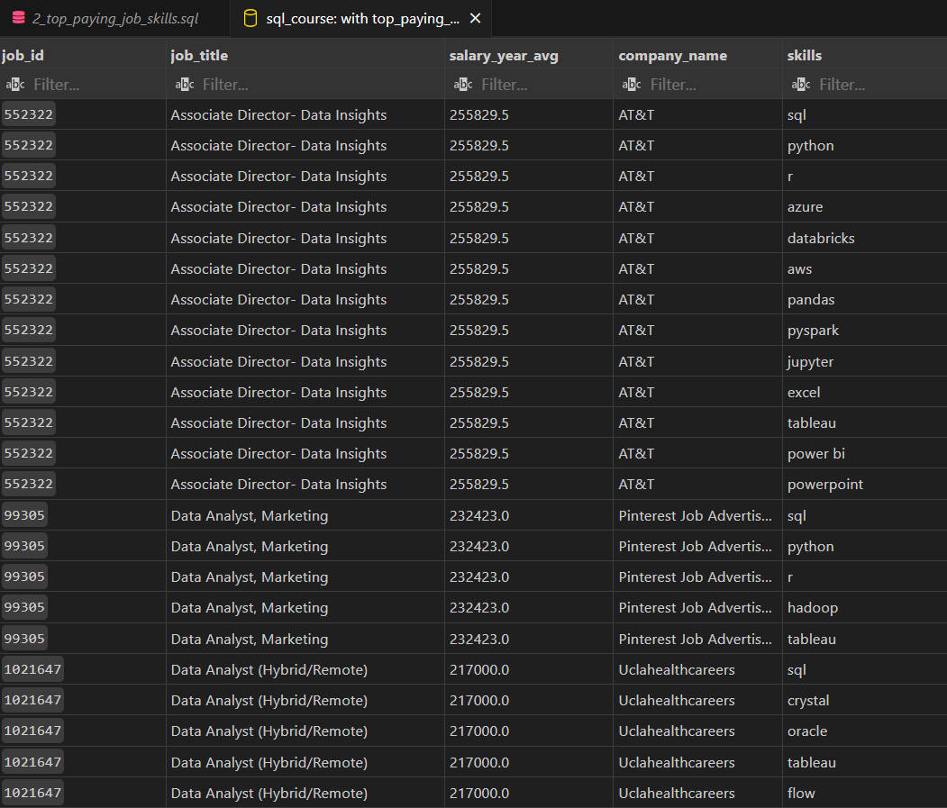
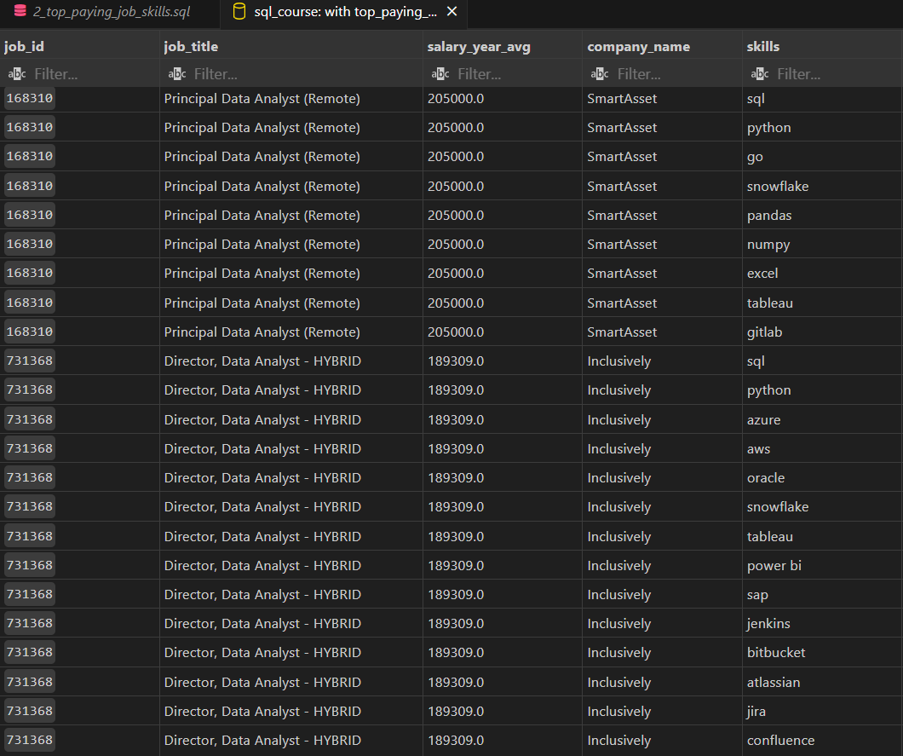
Top 10 Data Analyst Jobs based on Highest Salary and their Required Skills as Job Specification

Slide 7
Question 3 - What are the most in demand skills for ad Data Analyst Role - Identify the Top 10 skills for Data Analyst Job Position across all Platform and Companies - Focus on All job postings - Why? Retrieves the top 5 skills required to be a Data Analyst to be relevant in the job market
SELECT
skills_to_jobs.skill_id,
skills_table.skills,
count(jobs_table.job_id) as Total_jobs
from job_postings_fact as jobs_table
INNER JOIN skills_job_dim as skills_to_jobs
ON jobs_table.job_id = skills_to_jobs.job_id
INNER JOIN skills_dim as skills_table
ON skills_to_jobs.skill_id = skills_table.skill_id
where job_title_short='Data Analyst'
GROUP BY skills_to_jobs.skill_id, skills
ORDER BY Total_jobs DESC
LIMIT 10;

Slide 8
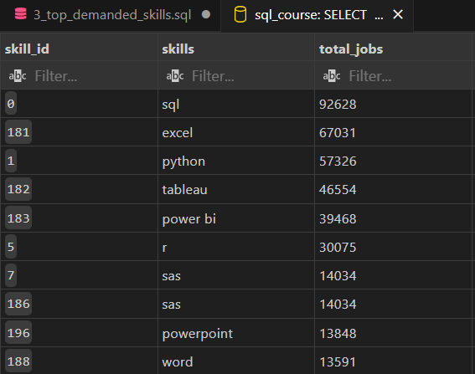
Top 10 Skills Required to be a Data Analyst which are high in Demand With Job Counts Across all Platform

Slide 9
Question 4 : What are the top paying skills based on salary - Look at the average salary associated with each skill for Data Analyst Position - Focuses on roles based on Salaries regardless of location - Why? It defines how different skills impact the Overall Salary for a job person and to find most financially rewarding skill to learn and improve
SELECT
skills_table.skill_id,
skills_table.skills,
ROUND(AVG(salary_year_avg),0) as avg_salary
from job_postings_fact AS jobs_table
INNER JOIN skills_job_dim as skills_to_job
ON jobs_table.job_id = skills_to_job.job_id
INNER JOIN skills_dim as skills_table
ON skills_to_job.skill_id = skills_table.skill_id
WHERE job_title_short = 'Data Analyst' AND salary_year_avg IS NOT NULL
GROUP BY skills_table.skill_id, skills
ORDER BY avg_salary DESC
LIMIT 20;

Slide 10
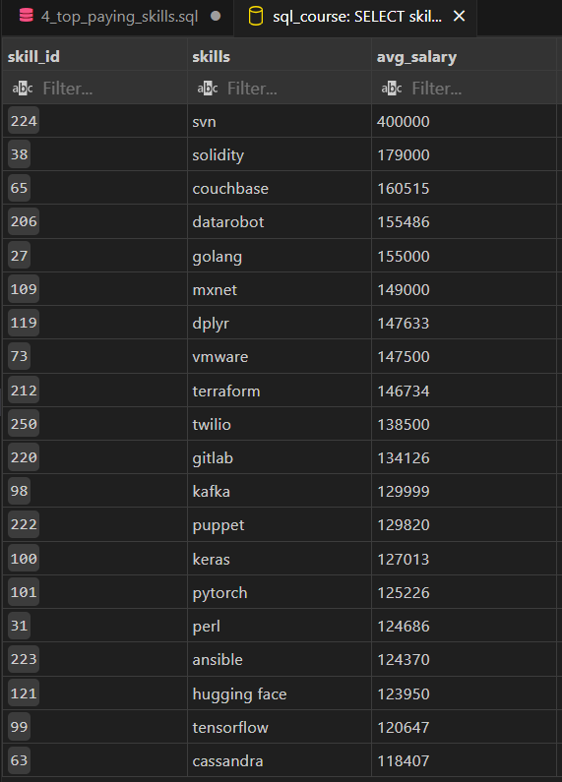
These Are the Top Skills to be a Data Analyst not on the basis of Job Count but what is the Average Salary One Might expect or what value this particular skill add to some one Package.
It is important to assess the financial metric of all skills important in Data Analyst Domain.

Slide 11
Question 5 : What are the best skills to learn aka best in demand and high in paying for Remote Jobs - Identify skills in high demand and with high average salaries for Data Analyst Roles - Why? Target skills offer job security as they are high in demand and financially They are sound as well as being high in salaries for career development in data analysis
WITH skills_demand AS (SELECT skills_table.skill_id,
skills_table.skills,
count(jobs_table.job_id) as total_jobs
from job_postings_fact as jobs_table
INNER JOIN skills_job_dim as skills_to_jobs
ON jobs_table.job_id = skills_to_jobs.job_id
INNER JOIN skills_dim as skills_table
ON skills_to_jobs.skill_id = skills_table.skill_id
WHERE job_title_short = 'Data Analyst'
AND salary_year_avg IS NOT NULL
AND job_work_from_home = TRUE
GROUP BY skills_table.skill_id, skills
), ----→
average_salary as(
SELECT skills_table.skill_id,
skills_table.skills,
ROUND(AVG(salary_year_avg),0) as avg_salary
from job_postings_fact AS jobs_table
INNER JOIN skills_job_dim AS skills_to_jobs
ON jobs_table.job_id = skills_to_jobs.job_id
INNER JOIN skills_dim as skills_table
ON skills_to_jobs.skill_id = skills_table.skill_id
WHERE job_title_short = 'Data Analyst'
AND salary_year_avg IS NOT NULL
AND job_work_from_home = TRUE
GROUP BY skills_table.skill_id, skills)

Slide 12
Continued from Previous Slide
WITH skills_demand AS (SELECT skills_table.skill_id,
skills_table.skills,
count(jobs_table.job_id) as total_jobs
from job_postings_fact as jobs_table
INNER JOIN skills_job_dim as skills_to_jobs
ON jobs_table.job_id = skills_to_jobs.job_id
INNER JOIN skills_dim as skills_table
ON skills_to_jobs.skill_id = skills_table.skill_id
WHERE job_title_short = 'Data Analyst'
AND salary_year_avg IS NOT NULL
AND job_work_from_home = TRUE
GROUP BY skills_table.skill_id, skills
), ----→
average_salary as(
SELECT skills_table.skill_id,
skills_table.skills,
ROUND(AVG(salary_year_avg),0) as avg_salary
from job_postings_fact AS jobs_table
INNER JOIN skills_job_dim AS skills_to_jobs
ON jobs_table.job_id = skills_to_jobs.job_id
INNER JOIN skills_dim as skills_table
ON skills_to_jobs.skill_id = skills_table.skill_id
WHERE job_title_short = 'Data Analyst'
AND salary_year_avg IS NOT NULL
AND job_work_from_home = TRUE
GROUP BY skills_table.skill_id, skills)
SELECT skills_demand.*,
average_salary.avg_salary
from skills_demand
INNER JOIN average_salary
on skills_demand.skill_id = average_salary.skill_id
ORDER BY total_jobs DESC;
The Idea here is to find the skills with most Job count and then Find the avg salary of the Relevant skill so that It can be easy for Aspiring Data Analyst to Choose the Learning Point which can give them a chance to start working in the Data Domain and at the same Time can provide enough Financial Stability as well.

Slide 13
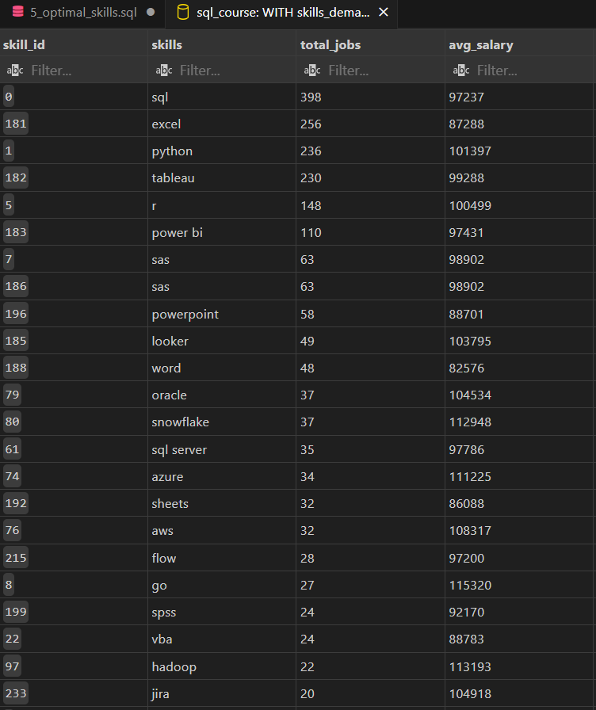
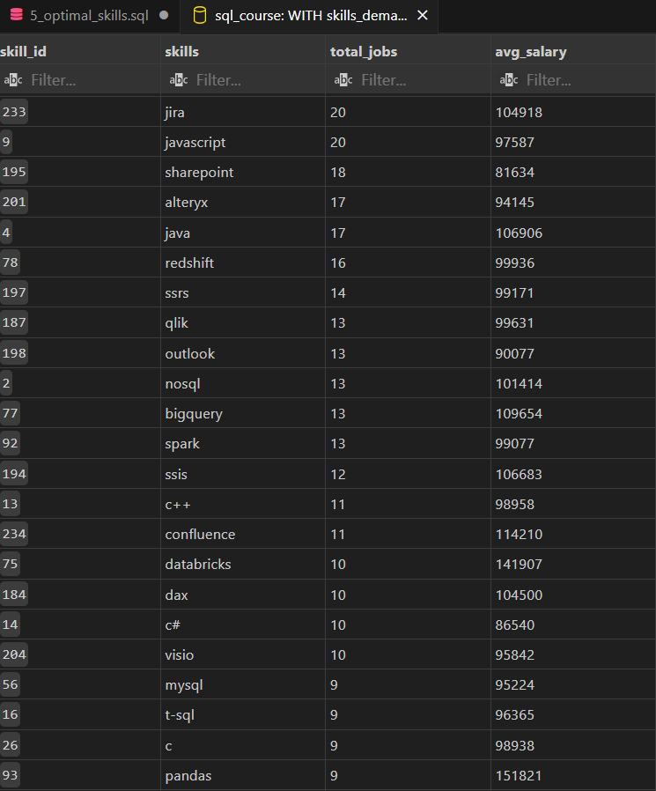
W
O
R
K
F
R
O
M
H
O
M
E
I
S
T
R
U
E

Slide 14
Conclusion
It was Done on Real Job Posting Collected from Various Websites and Platform So it is a Real Dataset.
The Data Analyst Job Market is Expanding and It is the right time to Upskill Yourself
For More Info Watch This Video
https://www.youtube.com/watch?v=7mz73uXD9DA

